Slide 1

IOT based smart wearable safety gadget
Group-7
Amandeep Kaur(748434)

Slide 2
Interfacing of panic button with LPC2148

Slide 3
Registers
PINSEL
IODIR
IOSET
IOPIN
IOCLR

Slide 4
Pin Select register
PINSEL P0.0 | operation
00 | GPIO
01 | TXD
10 | PWM
11 | Reserved

Slide 5
IODIR,IOSET,IOCLR,IOPIN
IODIR : used to provide direction to devices.
For example: To set 0 pin as an output = 0x00000001
For example: To set 5 pin as an output. =0x00000020
0 | 0 | 0 | 0 | 0 | 0 | 0 | 0 | 0 | 0 | 0 | 0 | 0 | 0 | 0 | 0 | 0 | 0 | 0 | 0 | 0 | 0 | 0 | 0 | 0 | 0 | 0 | 0 | 0 | 0 | 0 | 1
0 | 0 | 0 | 0 | 0 | 0 | 0 | 0 | 0 | 0 | 0 | 0 | 0 | 0 | 0 | 0 | 0 | 0 | 0 | 0 | 0 | 0 | 0 | 0 | 0 | 0 | 1 | 0 | 0 | 0 | 0 | 0

Slide 6
IOSET: used to send high logic(on mode).
For example= IOSET0=(1<<0)
IOSET1=(1<<5)
IOCLR : used to send low logic(off mode).
IOCLR0=(1<<0)
IOCLR1=(1<<5)
IOPIN: used to read an input.

Slide 7
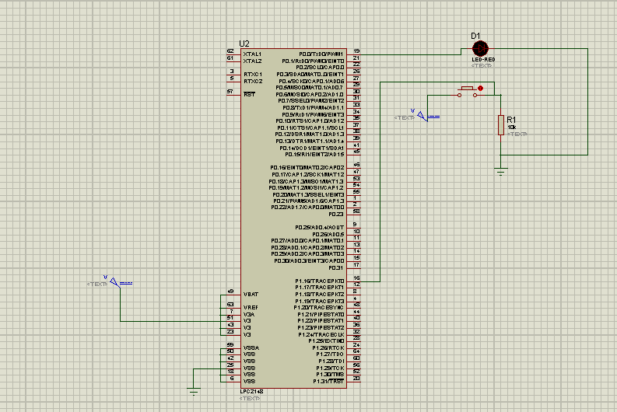
Schematic design with panic button

Slide 8
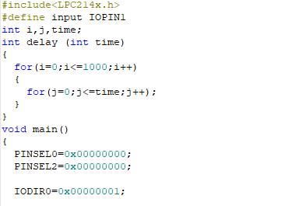
Coding

Slide 9
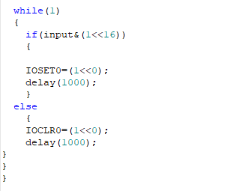
Coding

Slide 10
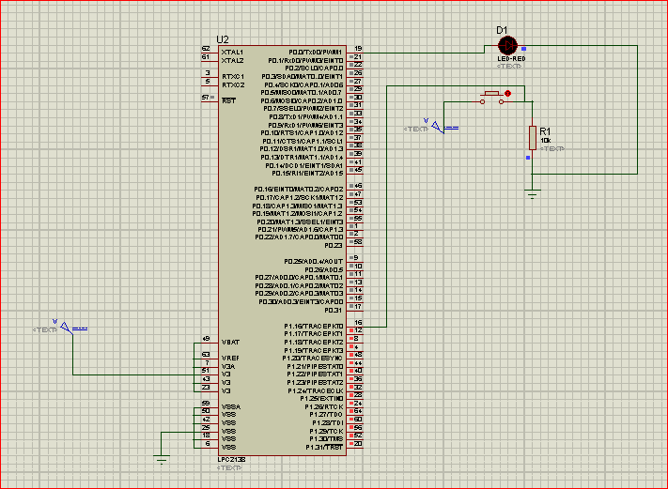
Simulation

Slide 11
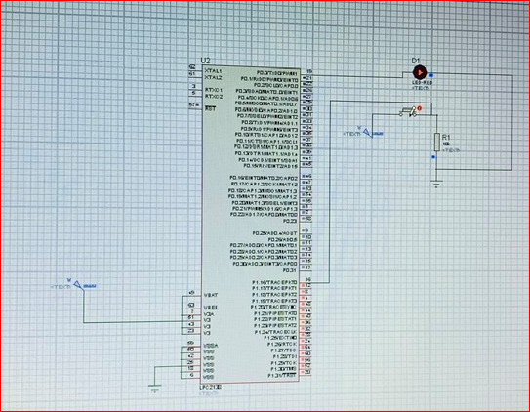
When button will be pressed , LED will glow.

Slide 12
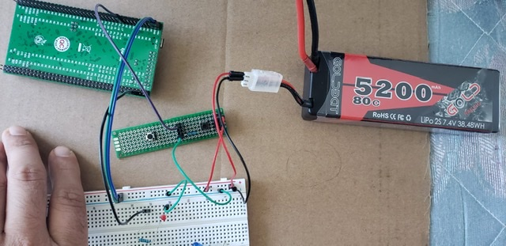
Hardware implementation with Panic button

Slide 13
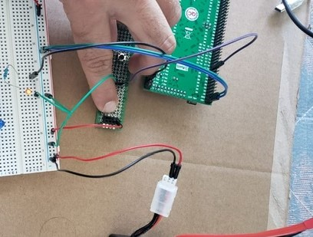

Slide 14
References
Tejonidhi.M.R.,Dyana. M.K.Aishwarya, Nagamma.H., Chaithara.K.S. (2019),IOT based smart secuirty gadget for women’s safety, International Conference on Advance in Information Technology. https://ieeexplore.ieee.org/document/8987242.
Electronic hub(2016).Arm GPIO Introduction.
https://www.electronicshub.org/arm-gpio-introduction.
Embetronix.(2020). lpc-gpio-tutorial-led-interfacing.
https://embetronicx.com/tutorials/microcontrollers/lpc2148/lpc2148-gpio-tutorial-led-interfacing/

